Slide 1
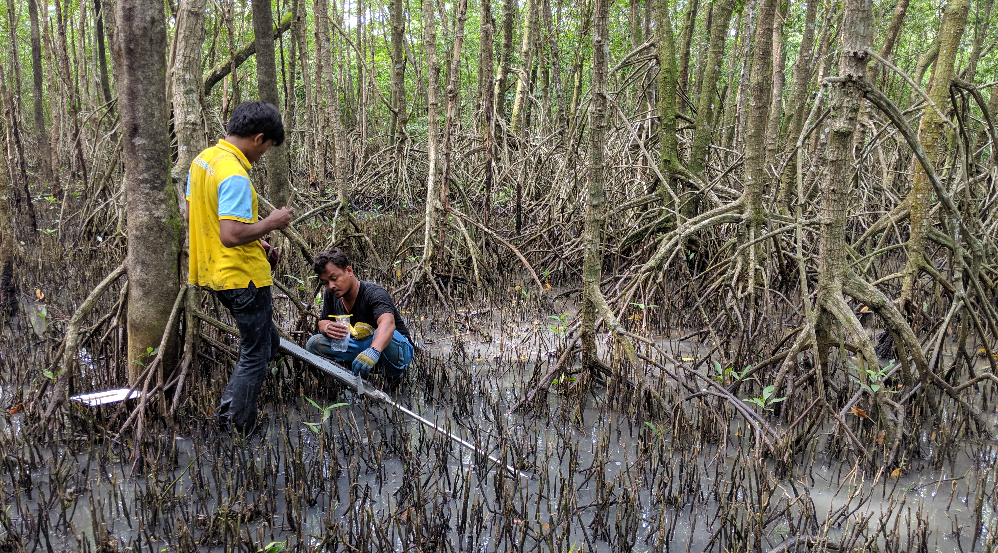
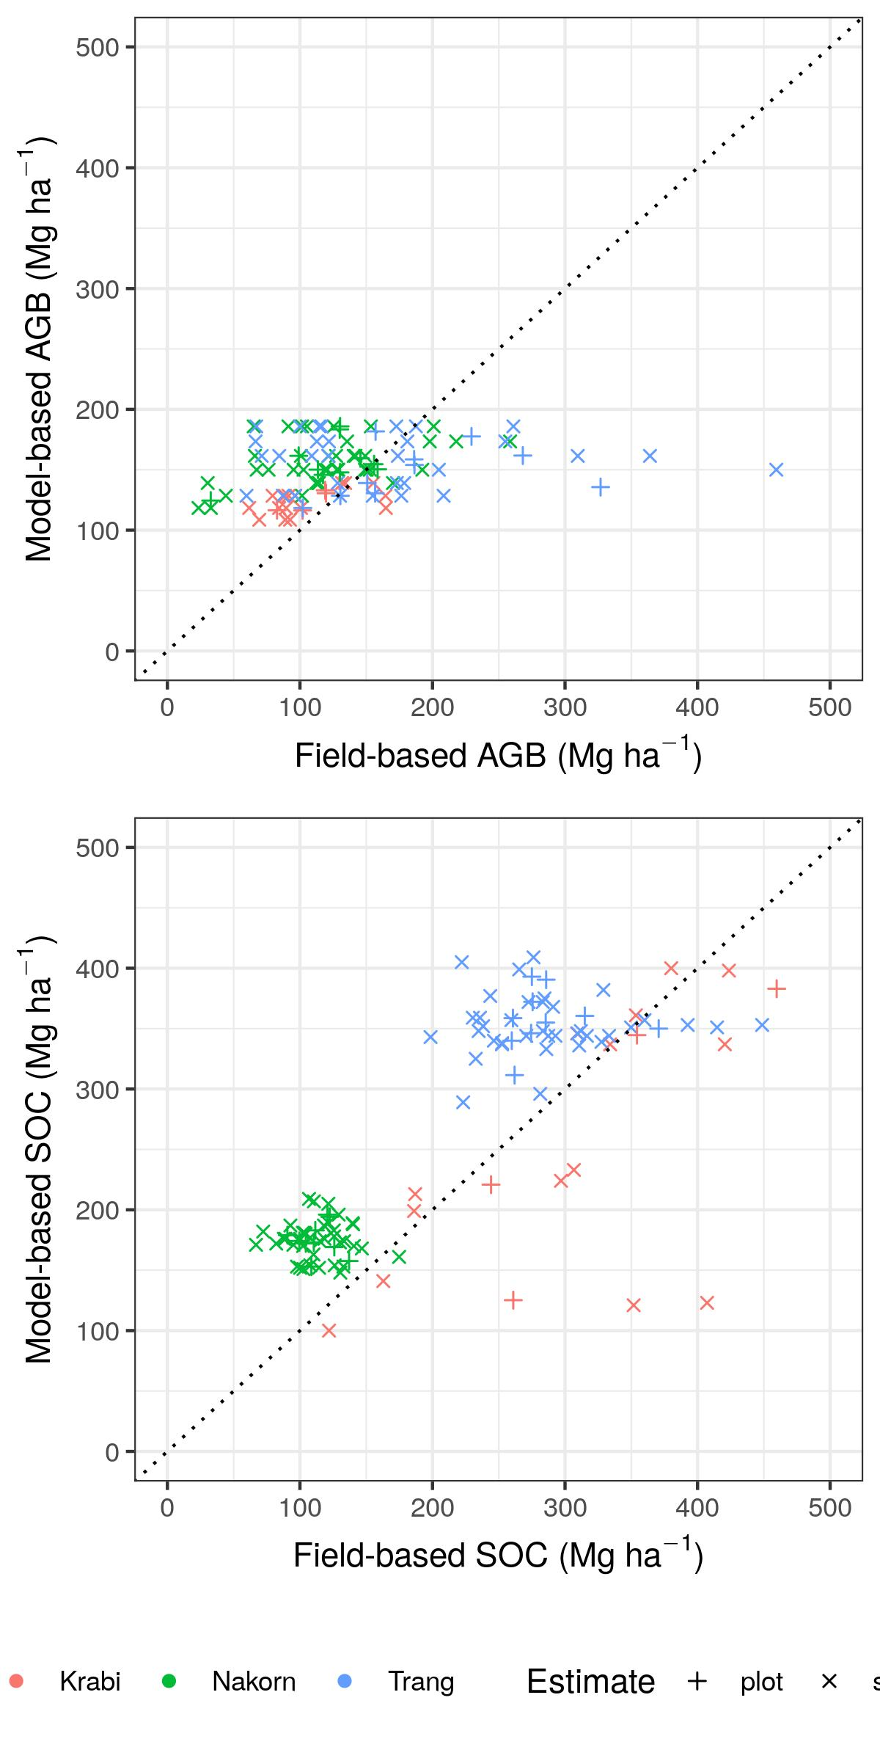
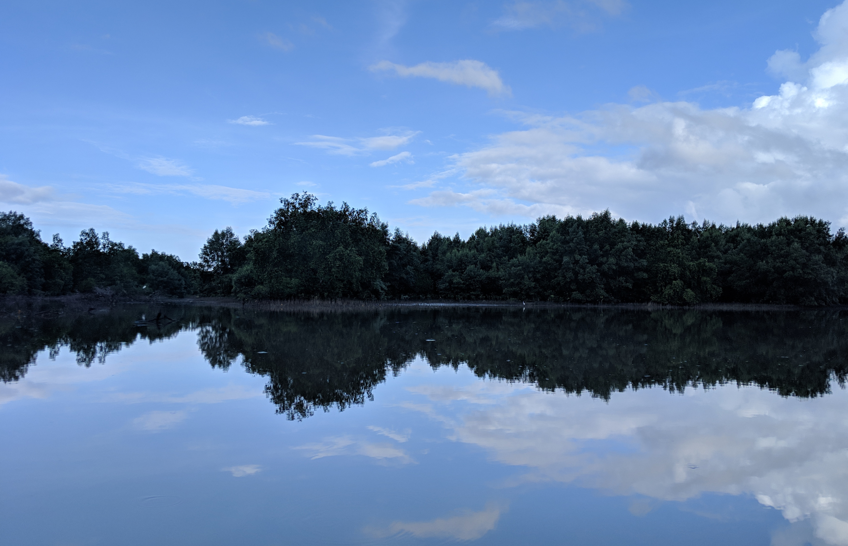
Designing carbon offset programs with field or model data: Any difference? Jacob J. Bukoski¹, Angie Elwin², Rich MacKenzie³, Matthew D. Potts¹
¹Department of Environmental Science, Policy and Management, University of California, Berkeley
²Department of Geography and Environmental Science, University of Reading, Reading, UK ³Institute for Pacific Island Forestry, United States Forest Service
Introduction
Materials and Methods
Conclusions & Future Goals
California is a leader in land-based carbon management programs. California’s “cap and trade” program is one of the largest carbon markets globally. At present, it allows for companies to purchase emission offsets that help meet their emission targets by supporting domestic forest conservation.
California is now exploring a Tropical Forest Standard, a set of criteria that would allow tropical nations to enter California’s cap and trade system by reducing deforestation. Should the bill be endorsed, an avenue for California to offset emissions by conserving tropical forests would be established.
Mangroves – the coastal forests of the tropics – are among the world’s most efficient ecosystems at sequestering carbon (Donato et al., 2011, Nat. Clim. Change). Mangrove forests stock large amounts of organic carbon in their vegetation, but particularly in their water-logged soils. The water-logged soils suppress microbial activity, which slows soil carbon releases to the atmosphere and thus creates massive carbon stores in their soils.
For entrance into California’s cap and trade system, robust estimates of stocks, losses and gains of carbon in mangrove landscapes are compulsory. Global maps of mangrove carbon produced through modeling provide a cost-efficient means for estimating carbon stocks for nations with limited resources (Sanderman et al., 2018, Nat. Geosci., Simard et al., 2019, Nat Ecol. & Evol.); however, it is unclear whether these values hold at the site-level, in which projects would ultimately be implemented.
A note: While international land-based carbon offsets are not without their shortcomings (see www.redd-monitor.org), forest restoration remains one of the most widespread mechanisms for atmospheric greenhouse gases reductions. It is important that we assess their value through a critical lens.
We quantified ecosystem carbon stocks of intact mangroves at three sites in peninsular Thailand. The sites were selected to represent a range of hydrological and sedimentary characteristics given that these are known to influence mangrove carbon stocks. Plots were located in the forest using a simple random sample for each site. Biomass is estimated using species-specific allometric equations, and soil organic carbon is estimated to 1 m depth. All field sampling followed standardized methods for estimation of forest structure and carbon stocks in mangroves (Kauffman and Donato, 2012, CIFOR).
To examine the accuracy of global mangrove carbon maps, we extract modeled estimates of aboveground biomass and soil organic carbon for each of our subplot locations. We couple the modeled estimates with the field-based estimates of carbon stocks derived from our sampling campaign. We aggregate the subplot data to the plot and site level, and compare each level of aggregation (subplot, plot and site) for the field-based vs. model-based estimates. We use Kruskal-Wallis tests to test for significant differences between the modeled and field-based estimates given non-normality in the data.
The findings show variable results between model-based and field-based estimates of carbon stocks. When designing carbon offset programs, model-based estimates will be useful for a first-estimate guess at extant stocks. However, model-based estimates should be coupled with field-based sampling to help constrain uncertainty. Use of the modeled datasets to help stratify sampling (e.g., across regions of high vs. low biomass) at the site level will help reduce both costs and uncertainty.
Future research will expand this work by a) quantifying and mapping land cover change across Thailand as a whole, and b) using optimization methods to incorporate economic and social criteria into priority maps of appropriate sites for mangrove restoration.
Fig. 2. Comparison of plot- and subplot-level estimates of mangrove biomass and soil organic carbon using field-based and model-based estimates. AGB is aboveground biomass whereas SOC is soil organic carbon.
Results and Outcomes
We find high variability between the field and model-based estimates of mangrove forest carbon. At the site-level, there is no consistent trend in predictability across the three sites. For aboveground biomass, we find a significant difference between the field-based and model-based estimates for one site. For soil organic carbon, we find significant differences between two sites (see Fig. 1).
At the plot and subplot level, there are large discrepancies between the field-based and model-based estimates of aboveground biomass (see Fig. 2). Notably, the field-based estimates of aboveground biomass vary from <50 Mg ha⁻¹ to > 400 Mg ha⁻¹, whereas the modeled estimates are constrained between 100 and 200 Mg ha⁻¹. For soil organic carbon, the modeled data explained variation across sites, but was variable at the plot or subplot level.
Implications: Carbon offset programs are likely to be designed and implemented at the site level, with plot or subplot level measurements used for monitoring carbon gains over time. While model-based data are useful for initial estimates of carbon stocks, field-based data will still be of key import for implementing offset programs.
Project Goals
The overarching goal of this project was to assess the utility of global maps of mangrove aboveground biomass and soil organic carbon for estimating biomass and carbon stocks at scales relevant for project implementation.
Acknowledgements
Fig. 1. Ecosystem carbon stocks of the mangroves and abandoned aquaculture ponds for the three sites.
The authors thank UCOP, the Center of Southeast Asia Studies at UC-Berkeley, and a NSF Graduate Research Fellowship for their support of this research. We also thank the many field crews for their assistance in the field. We also thanks Dr. John J Battles for his nomination of JJB for the CNI fellowship.
 | Krabi |  | Nakorn |  | Trang
 | Aboveground Biomass (Mg ha⁻¹) | Soil Organic Carbon (Mg C ha⁻¹) | Aboveground Biomass (Mg ha⁻¹) | Soil Organic Carbon (Mg C ha⁻¹) | Aboveground Biomass (Mg ha⁻¹) | Soil Organic Carbon (Mg C ha⁻¹)
Field-based | 112 ± 2.73 | 316 ± 13.1 | 121 ± 5.51 | 113 ± 2.08 | 221 ± 11.9 | 283 ± 3.91
Model-based | 124 ± 1.77 | 268 ± 23.4 | 156 ± 2.44 | 175 ± 1.87 | 161 ± 3.57 | 354 ± 3.55
X² | 1.28 | 0.321 | 6.606 | 14.3 | 1.07 | 9.308
P-value | 0.257 | 0.571 | 0.012 | >0.001 | 0.301 | >0.001
Significance | NS | NS | ** | *** | NS | ***
Contact
Email: jbukoski@berkeley.edu
Twitter: @JacobBukoski
Note: NS = non significant, * = significant at 0.1, ** = significant at 0.05, *** significant at 0.01
Notes:
Phase II: In-depth assessment (similar to LEEDS) and information exchange with entire research group. Inform staff of support services, shared equipment, onservation impact, altered techniques or materials. Inquire: needs and concerns
Phase III: Follow up

